Slide 1
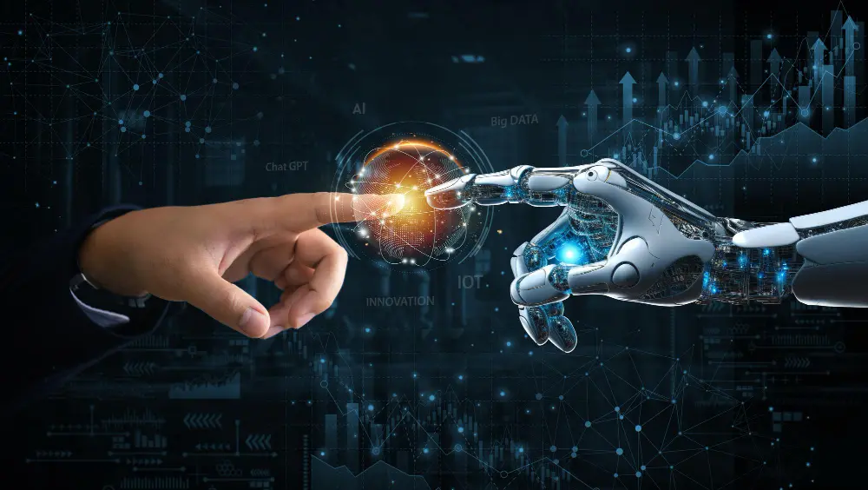
IMPACTS
TECHNOLOGY SECTOR
The fiscal measures undertaken by the government affect public expenditure.
For instance, an increase in direct taxes would decrease disposable income, thus reducing demand for goods.
This decrease in demand will translate into a decrease in production, therefore affecting economic growth.
Focuses on AI and semiconductors, praised by Microsoft India's Puneet Chandok.
A 52% funding increase to ₹21,936.90 crore supports semiconductors.
NXP's Hitesh Garg noted its electronics manufacturing role. ₹3 lakh crore will benefit women's skilling.
Budget emphasis on technological innovation and digitization sets India on the first track of becoming an ‘AI-FIRST NATION’ .

Slide 2
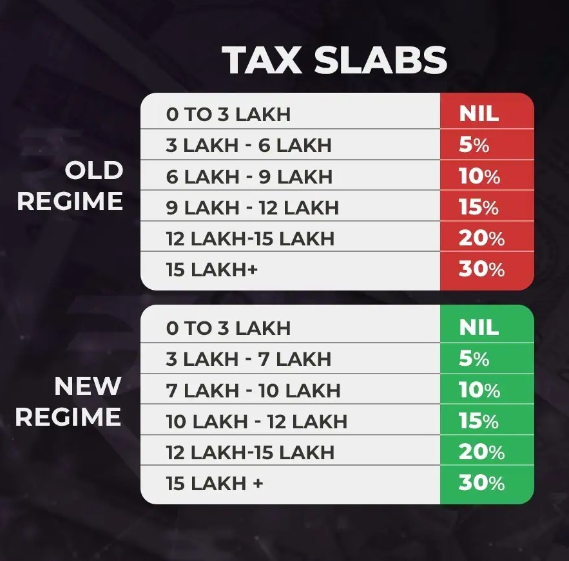
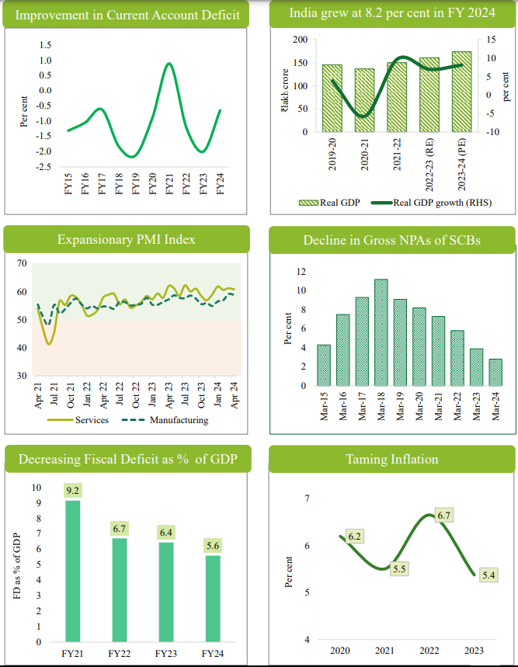
“The Union Budget 2024 brings substantial changes to personal finance that will benefit a large number of taxpayers. The increase in the standard deduction from Rs 50,000 to Rs 75,000 and the revision of the tax slab limit for the 5% tax rate from Rs 5 lakh to Rs 7 lakh will significantly enhance disposable income. These changes will provide much-needed financial relief to the middle class and boost overall consumption.
Short term gains of financial assets to attract 20%tax rate
Long term gains on all financial and non-financial assets to attract a tax rate of 12.5%
Increase in limit of exemption of capital gains on financial assets to Rs.1.25 lakh per year
Inflation is moving towards 4%.

Slide 3
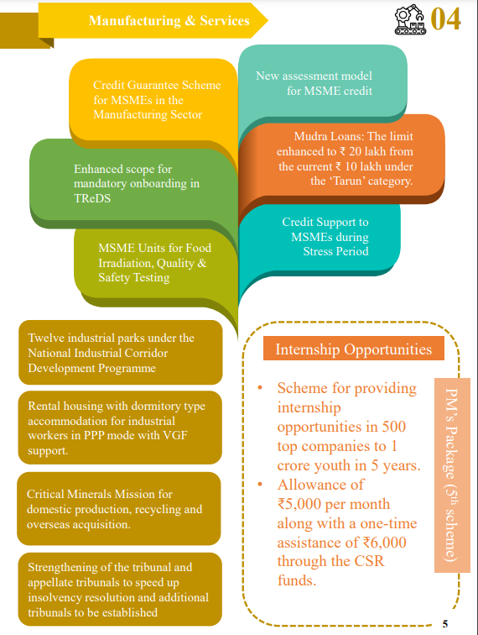
Manufacturing
And Service Sector
Budget
Allocation
With healthy bank and corporate balance sheets and capacity utilisation in many sectors signalling investment needs, the private sector is finally expected to join the capex bandwagon.

Slide 4
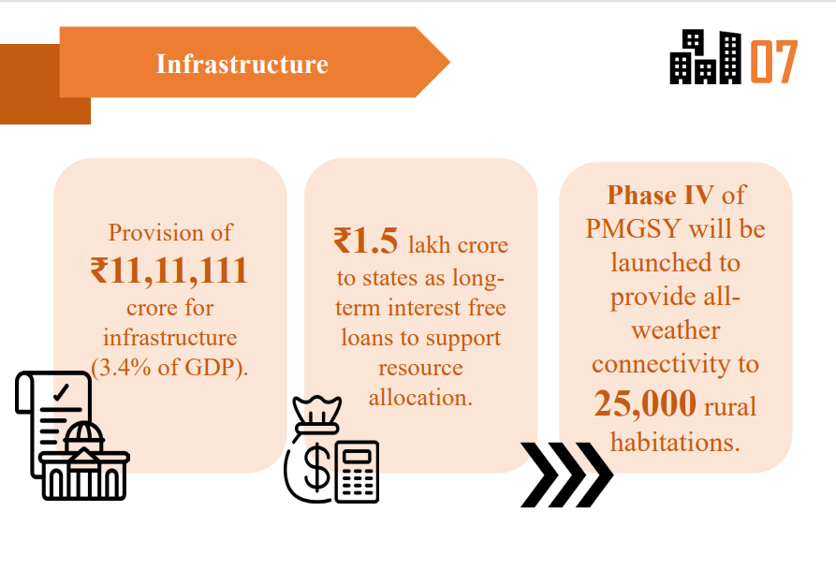
IMPACTS
Infrastructure, such as irrigation systems, cold storage, and more food processing units require massive public investment to create a robust food supply chain.

Slide 5
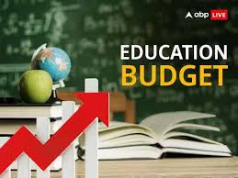
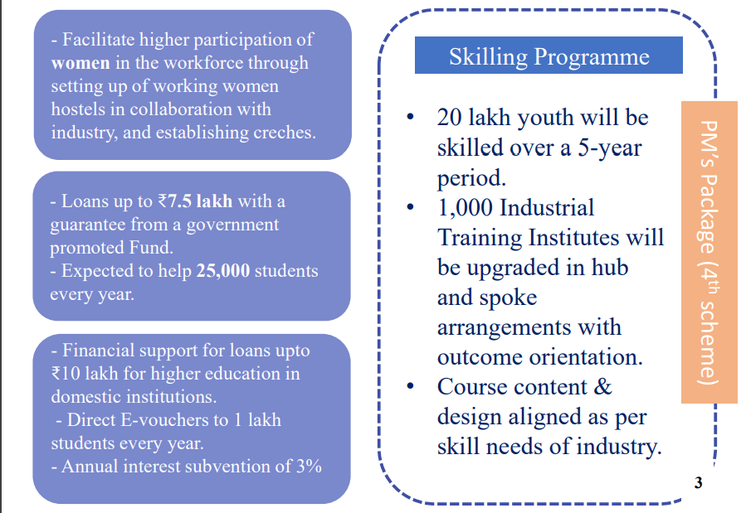
IMPACTS
Employment linked incentive scheme, similar to production linked incentive scheme, could also be introduced for incentivizing incremental job creation in labour intensive sectors
Targeted skilling initiatives should also be launched to address the needs of the industry, including preparing the workforce for the AI and GenAI needs. Similarly, many large construction and engineering, procurement, and construction (EPC) companies have highlighted a significant demand for skilled blue-collar workers.

